Slide 1
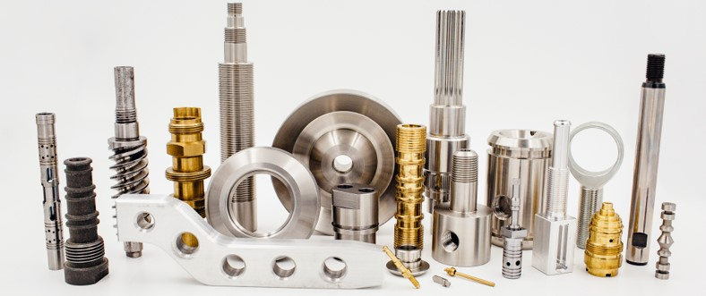
Machesney Park, Illinois

Slide 2
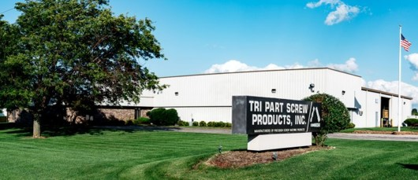
History
Tri Part was incorporated in the spring of 1982.
Tri Part is a family owned business, with multiple family members actively working daily.
- $7 million in sales annually.
Non union facility.
Current facility was built in 1990, and is 22,000 sq ft.
Industries Served: Hydraulics/Pneumatics, Aerospace, Gas & Oil, Agriculture, Marine, Construction/Off Road, Automotive, Mining, Firearms, & Energy.
Currently operate 2 shifts.
40 employees.
Engineering expertise within staff.

Slide 3
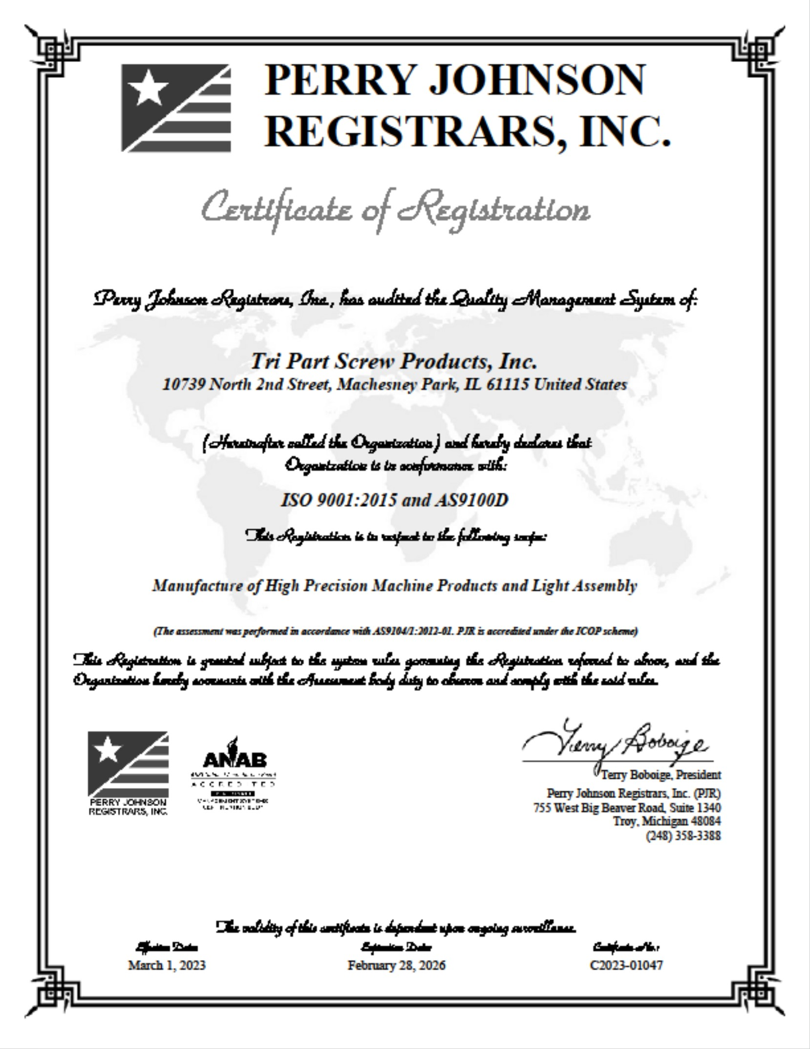
AS9100D & ISO 9001:2015 Certified

Slide 4
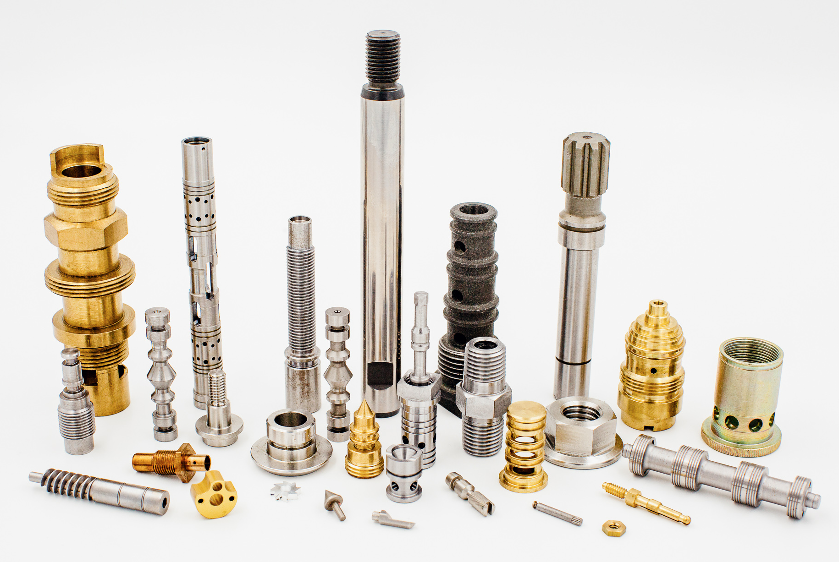
Materials & Run Sizes
Run sizes vary from 1pc prototype orders, to high volume production runs.
Stainless Steel
Carbon Steel
Alloys
G2 Cast Iron
Brass
Aluminum
Tool Steel
Specialty Metals
Titanium, Inconel, etc.
Plastics

Slide 5
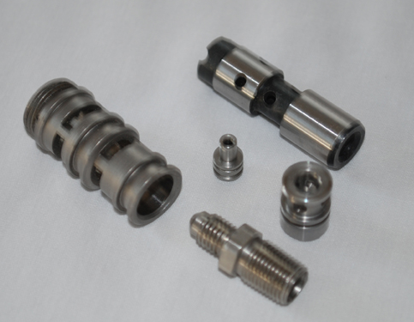
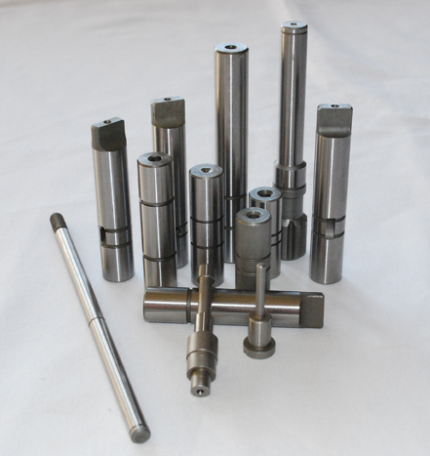
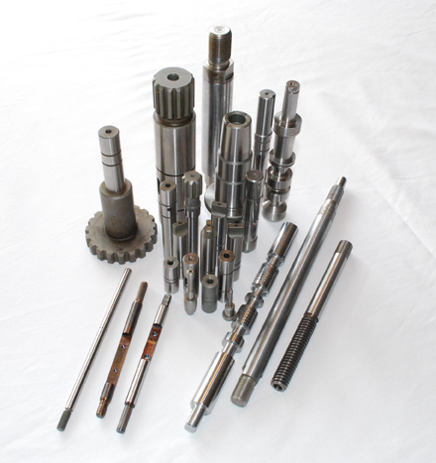
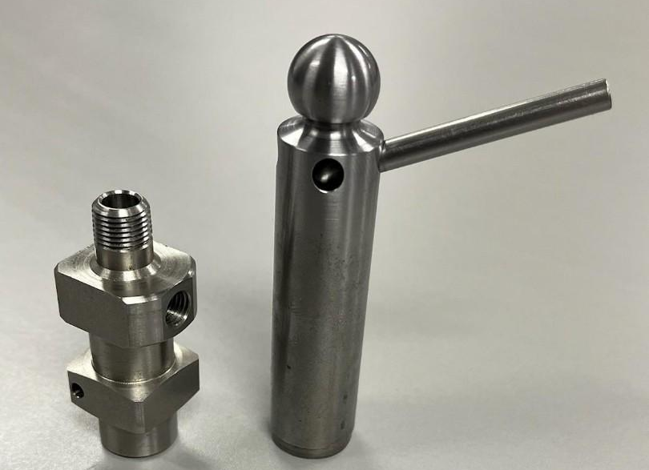
Machining Capabilities - Swiss
CNC Swiss – 12 Machines
Citizen – up to 10-Axis, up to 32mm stock, LFV (low frequency vibration control for chip control).
Deco – 12-Axis, sliding headstock, live tooling, up to 26mm.
Gepard – 8-Axis, live tooling, up to 32mm.

Slide 6
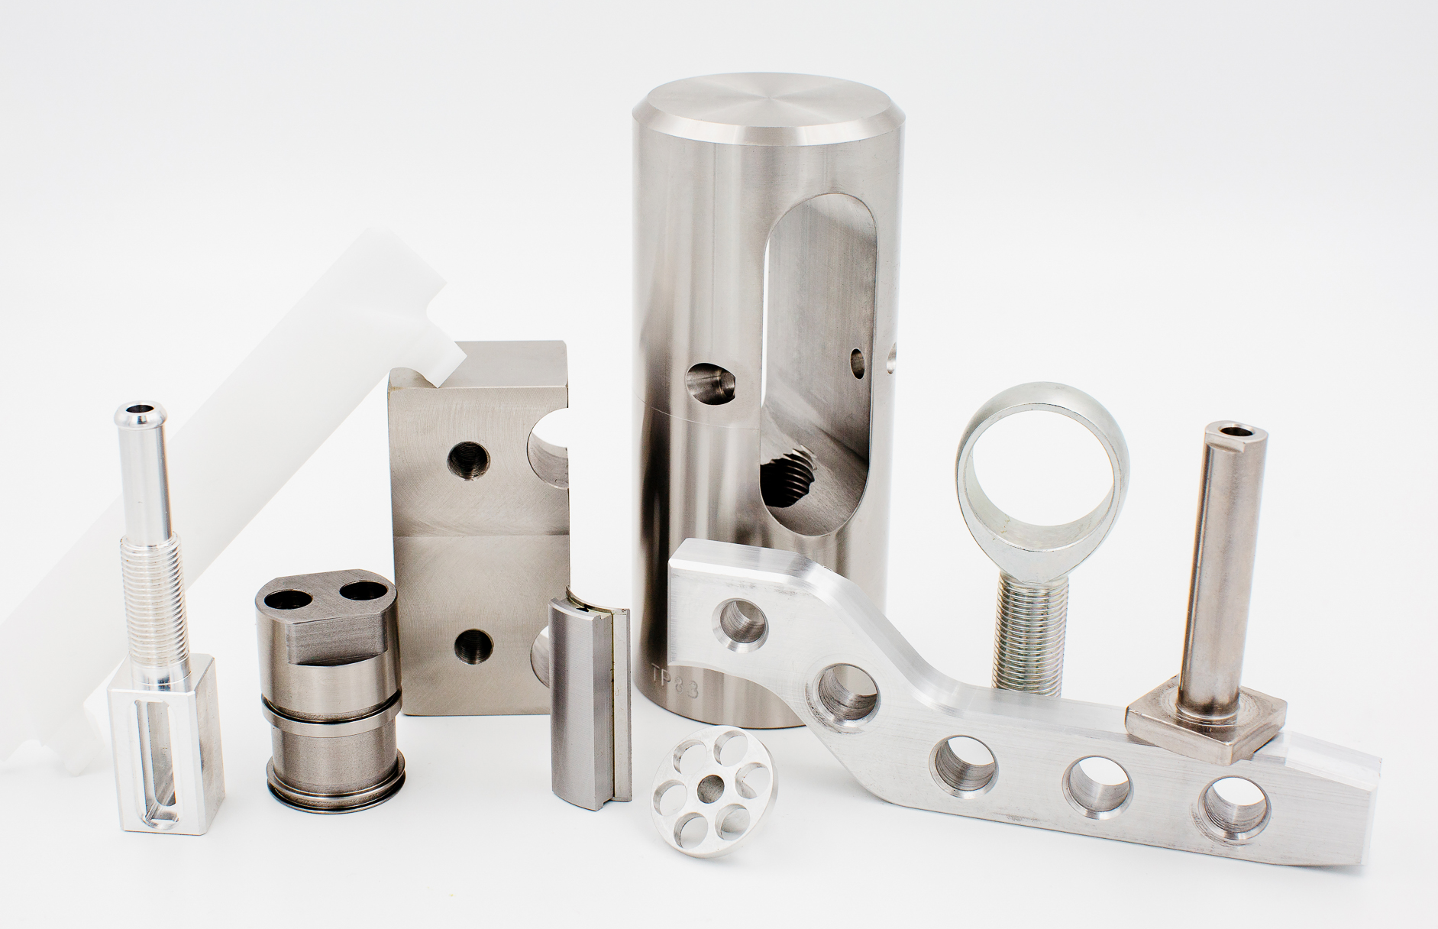
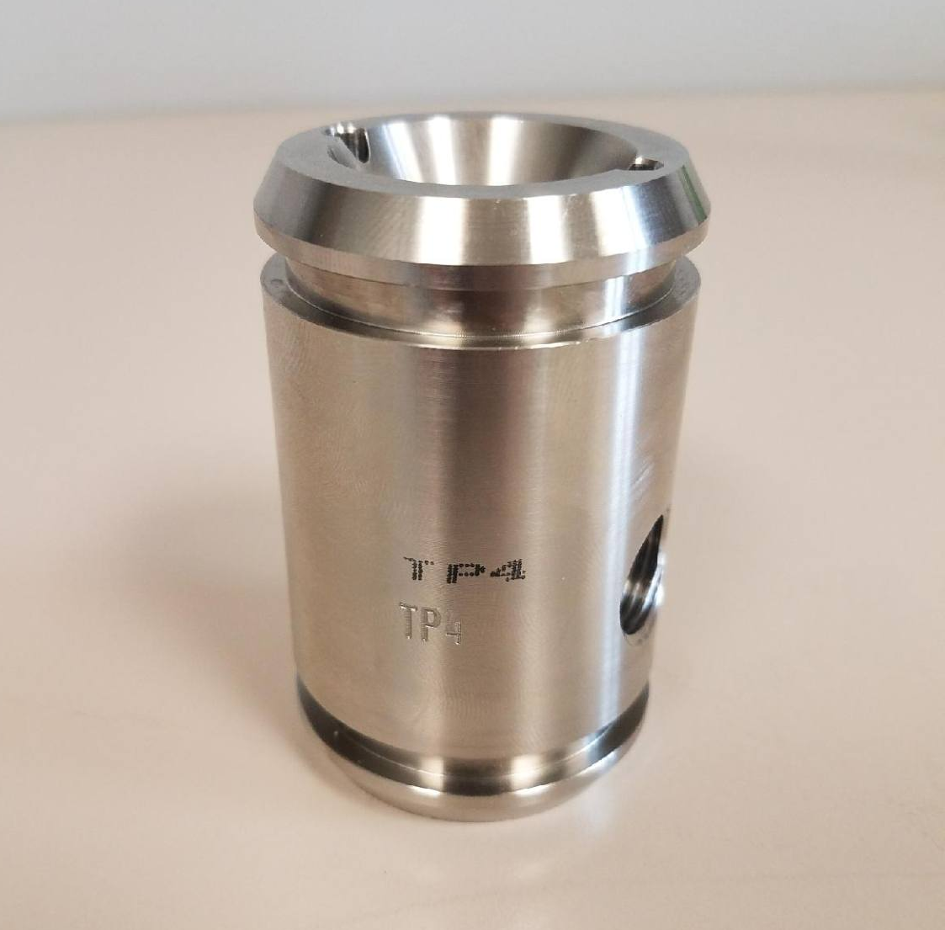
Machining Capabilities – CNC Lathe
CNC Lathe – 9 machines
Eurotech – twin turret, twin spindle, 24-station
live tooling, up to 2-3/4 RD.
Doosan – up to 3” thru spindle, and 10” chuck.
Samsung – up to 4” thru spindle.
Yama Seiki – 5-Axis, twin spindle, up to 2”.
Miyano – live tooling, up to 1-5/8” thru spindle,
and 5” chuck.
Other capabilities
Hard turning
Part Marking / Engraving

Slide 7
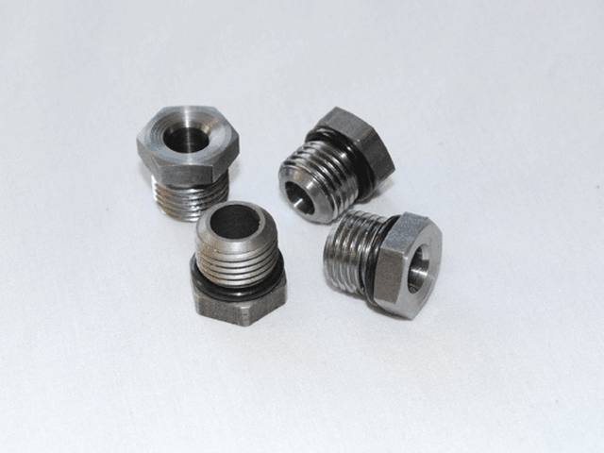
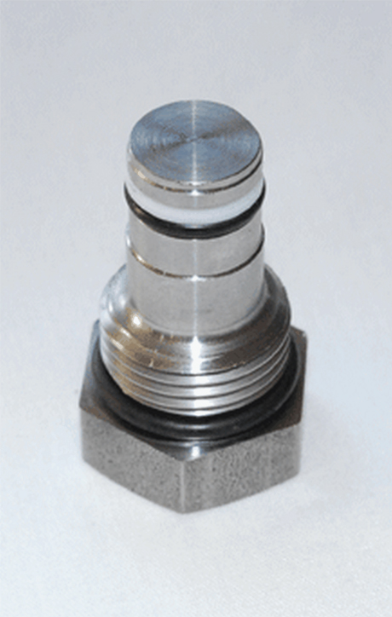
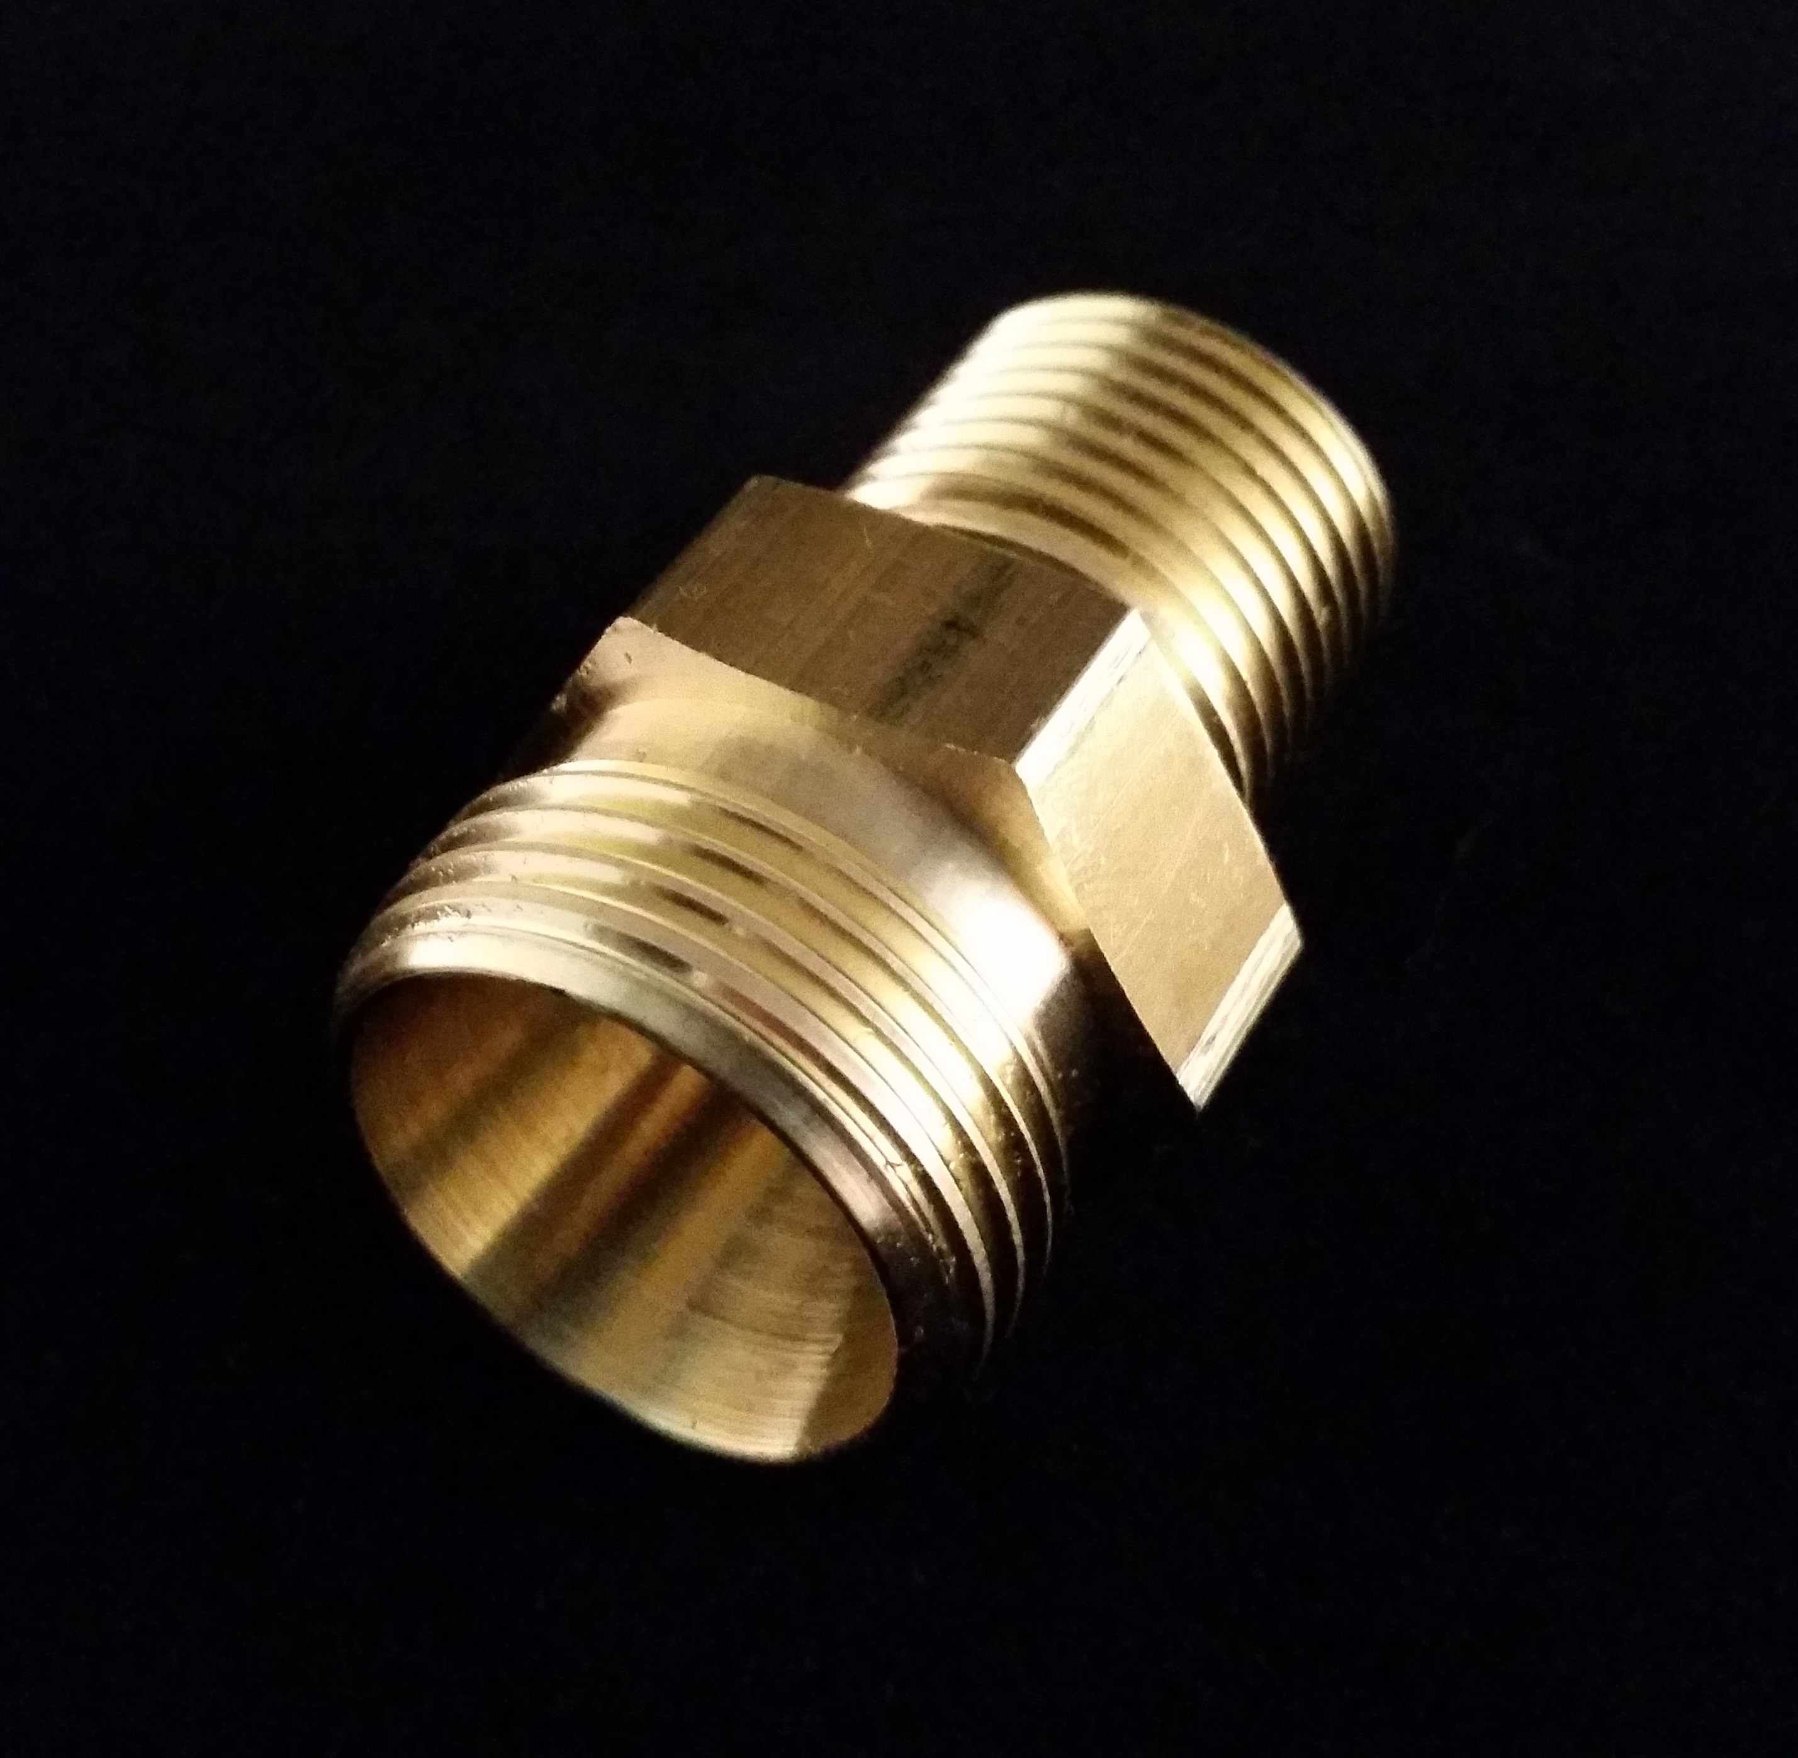
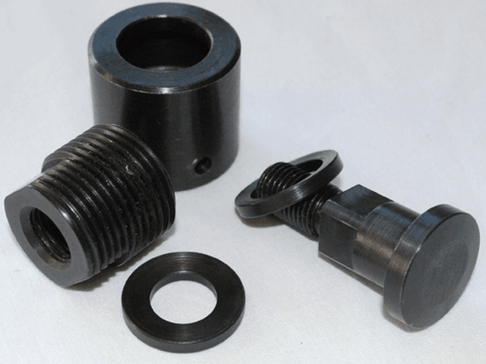
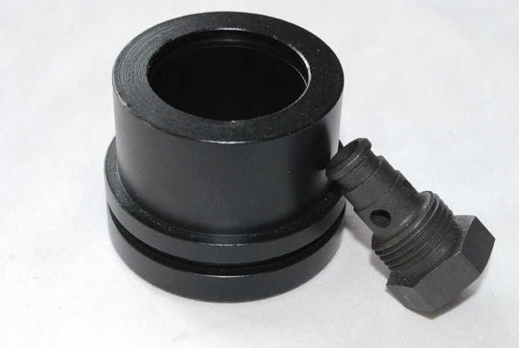
Machining Capabilities - Wickman
Wickman Multi-spindles – 7 Machines
Wickmans - 6 spindles, cross mill/drill, back mill/machine, up to 2-1/4 RD.

Slide 8
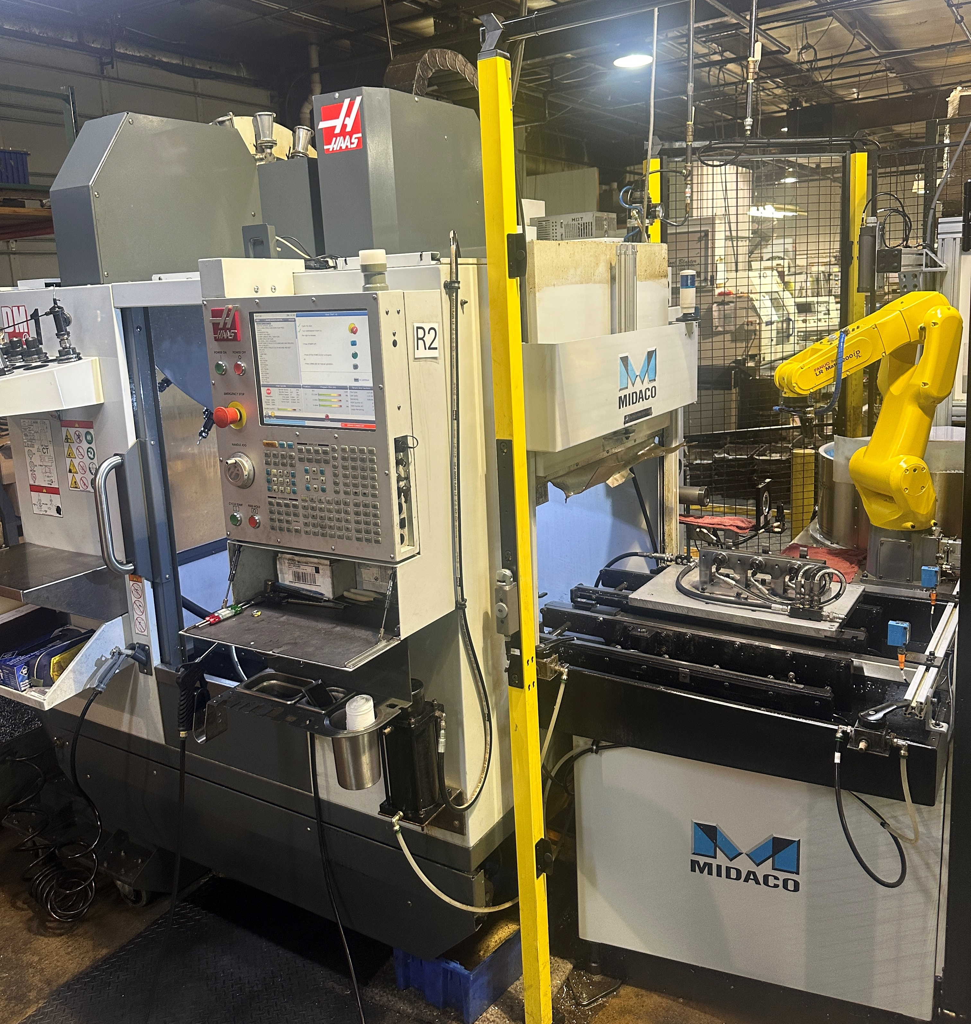
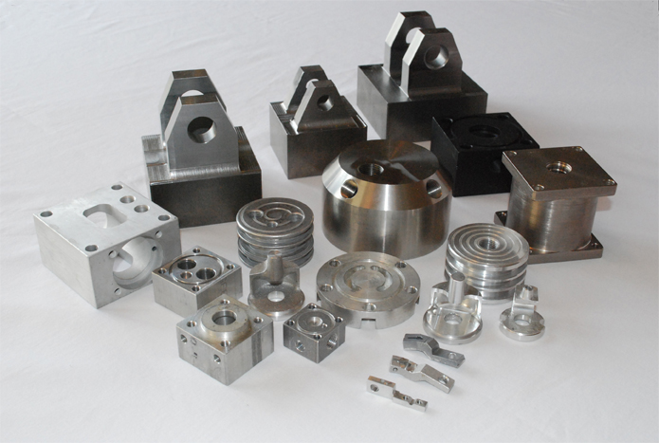
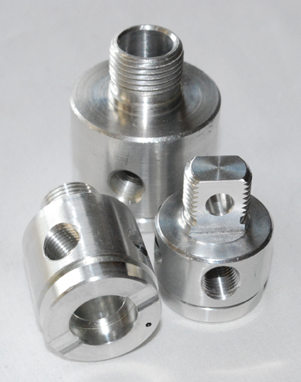
Machining Capabilities - Mill
Vertical Machining Centers – 3 Machines
Mills, 2 with pallet changer – 4-Axis, 20 tools.
Robotic capabilities on 2 machines.

Slide 9
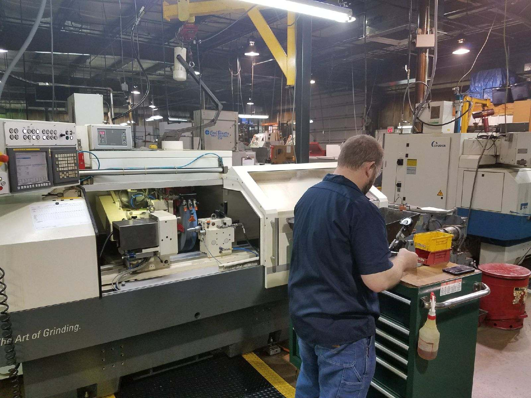
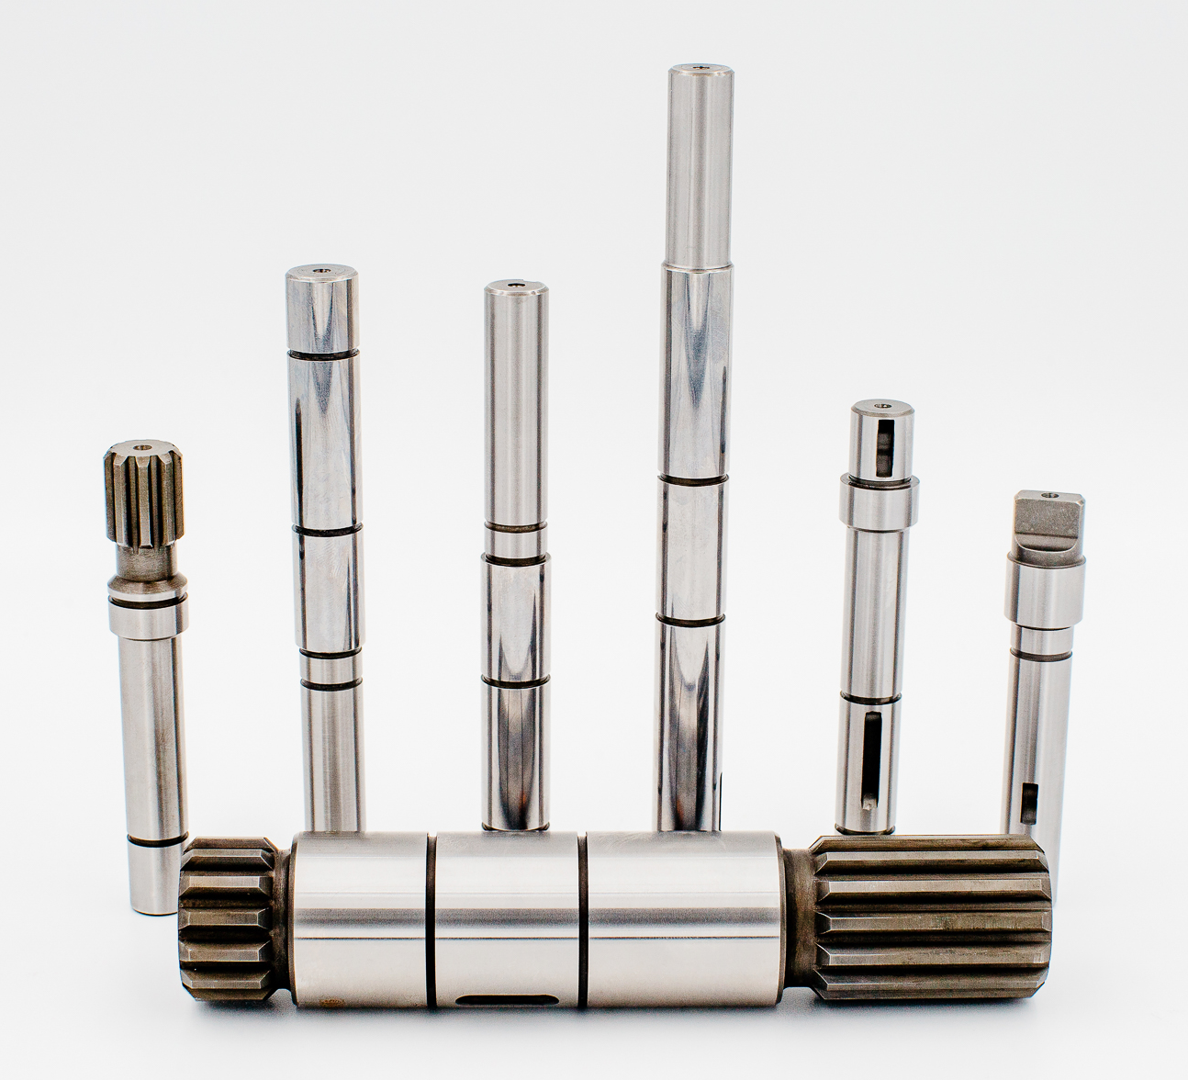
Machining Capabilities - Grinding
2 CNC Studer Grinders – for OD grinding on center.
2 Centerless Grinders – Thru Feed & In Feed.
Tolerances Held:
- Diameter: .0001 inch
- Roundness: .00005 Circularity
- Straightness: .0001/1.0 inch
- No-Lead: Ref: SAE J946
- Micro Finish: RA 2
- Size: Up to 6” diameter, & 10” OAL
-Tumbling and light assembly also available.

Slide 10
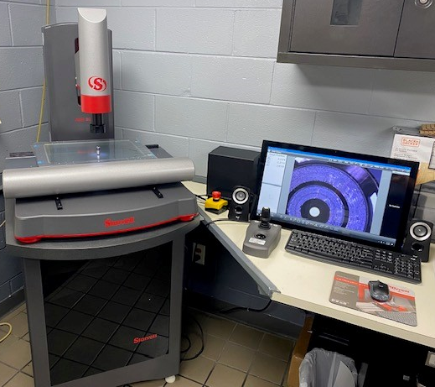
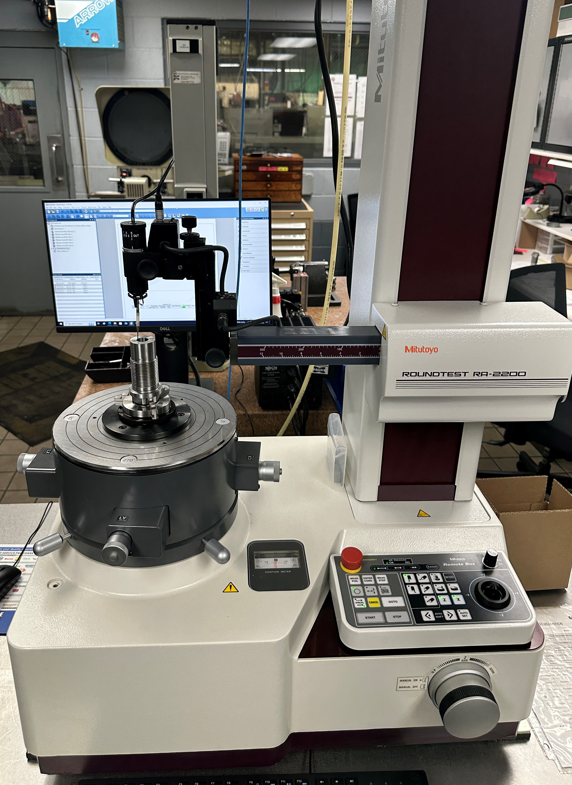
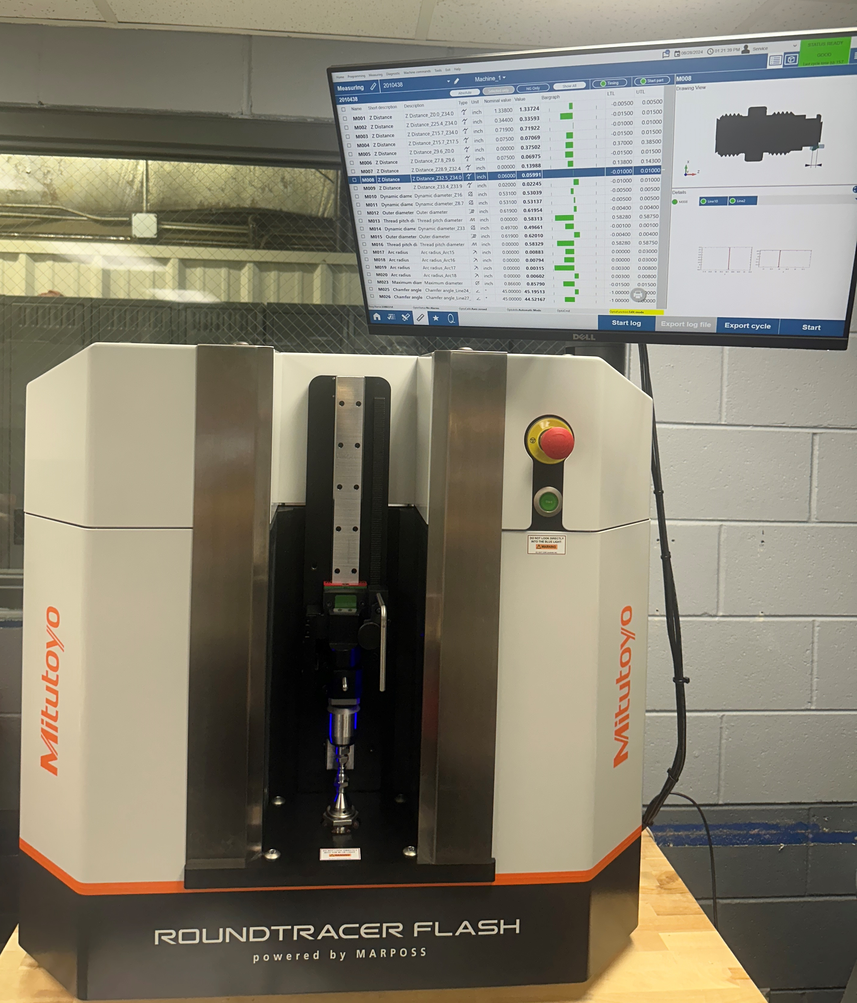
Quality Control
ISIR & PPAP capability.
Gage calibration control.
Standard Process:
First piece inspection.
Inspection of sample lot after each outside service.
Inspection of sample lot at completion of job.
Inspection Equipment:
Keyence Optical Measurement System
CMM - Starrett AVR 300 Vision System
Roundness – Mitutoyo RA-2200
HR-530 Hardness Tester
Profilometer SJ-410
Mitutoyo Roundtracer Flash
Niton XL5 Plus Material Analyzer

Slide 11
Additional Services
Tri Part has long standing relationships with vendors for the following added service processes:
Heat Treating
Plating (Chrome, Black Oxide, Zinc, etc.)
Teflon Coating
Grinding (if outside our capabilities)
Passivation
Honing
Hobbing & Shaping
Roll Threading

Slide 12
Inventory Programs
Tri Part currently manages stocking & Kanban programs for several customers, and tailors these programs to fit our customers needs.
Small quantity orders are typically made and shipped all at once.
Larger quantity orders may be placed on an annual blanket with releases to be sent as needed and within shipping term lead-times. Stocking levels and production run quantities are built into the inventory agreements. Annual blankets do not exceed an estimated 12 month supply.
Returnable packaging programs available.
Local delivery available via our truck.

Slide 13
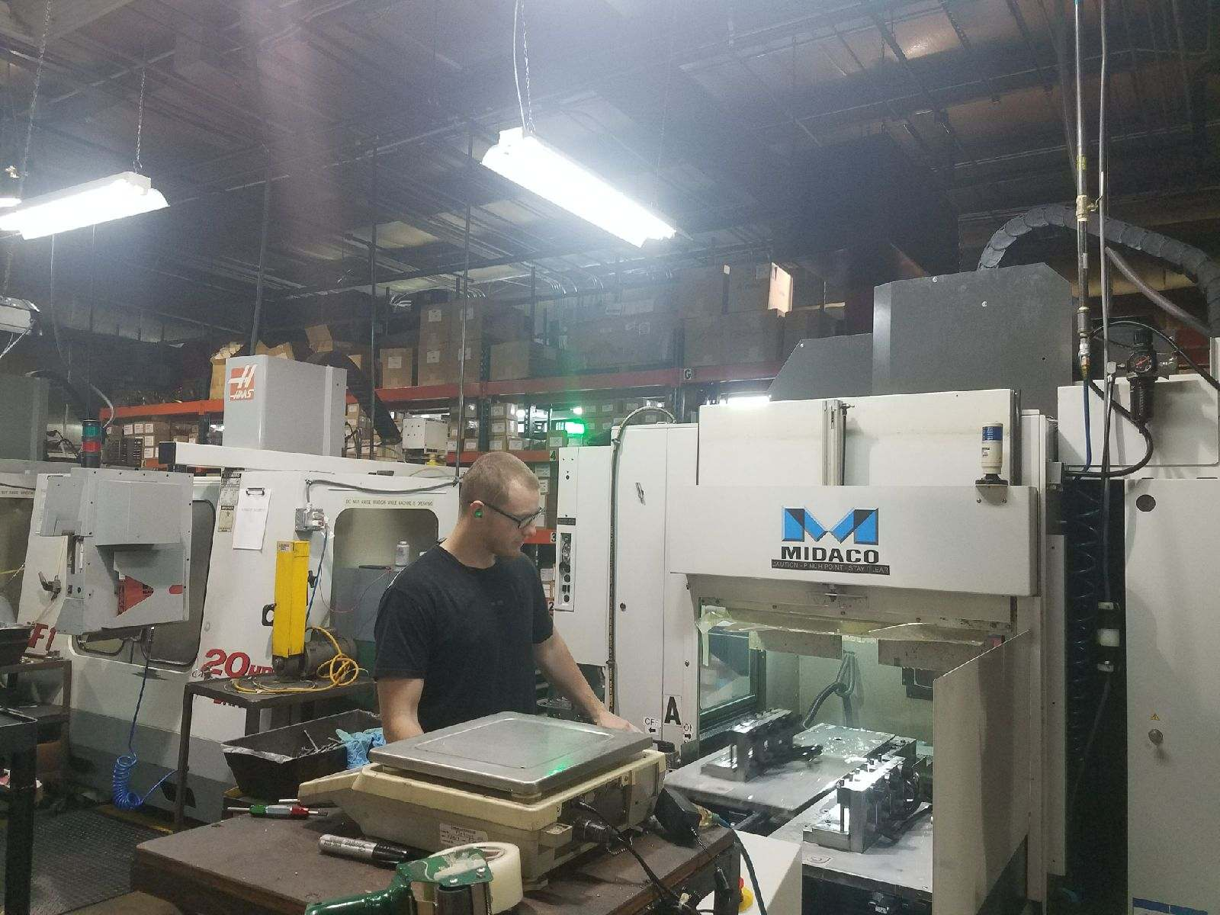
OTD, Capacity, PPM
Current OTD averages 92%
Capacity is currently at 60%
Currently have 5 people on 2nd shift,
so lots of room to grow.
PPM is 1053.745 for 2023.

Slide 14
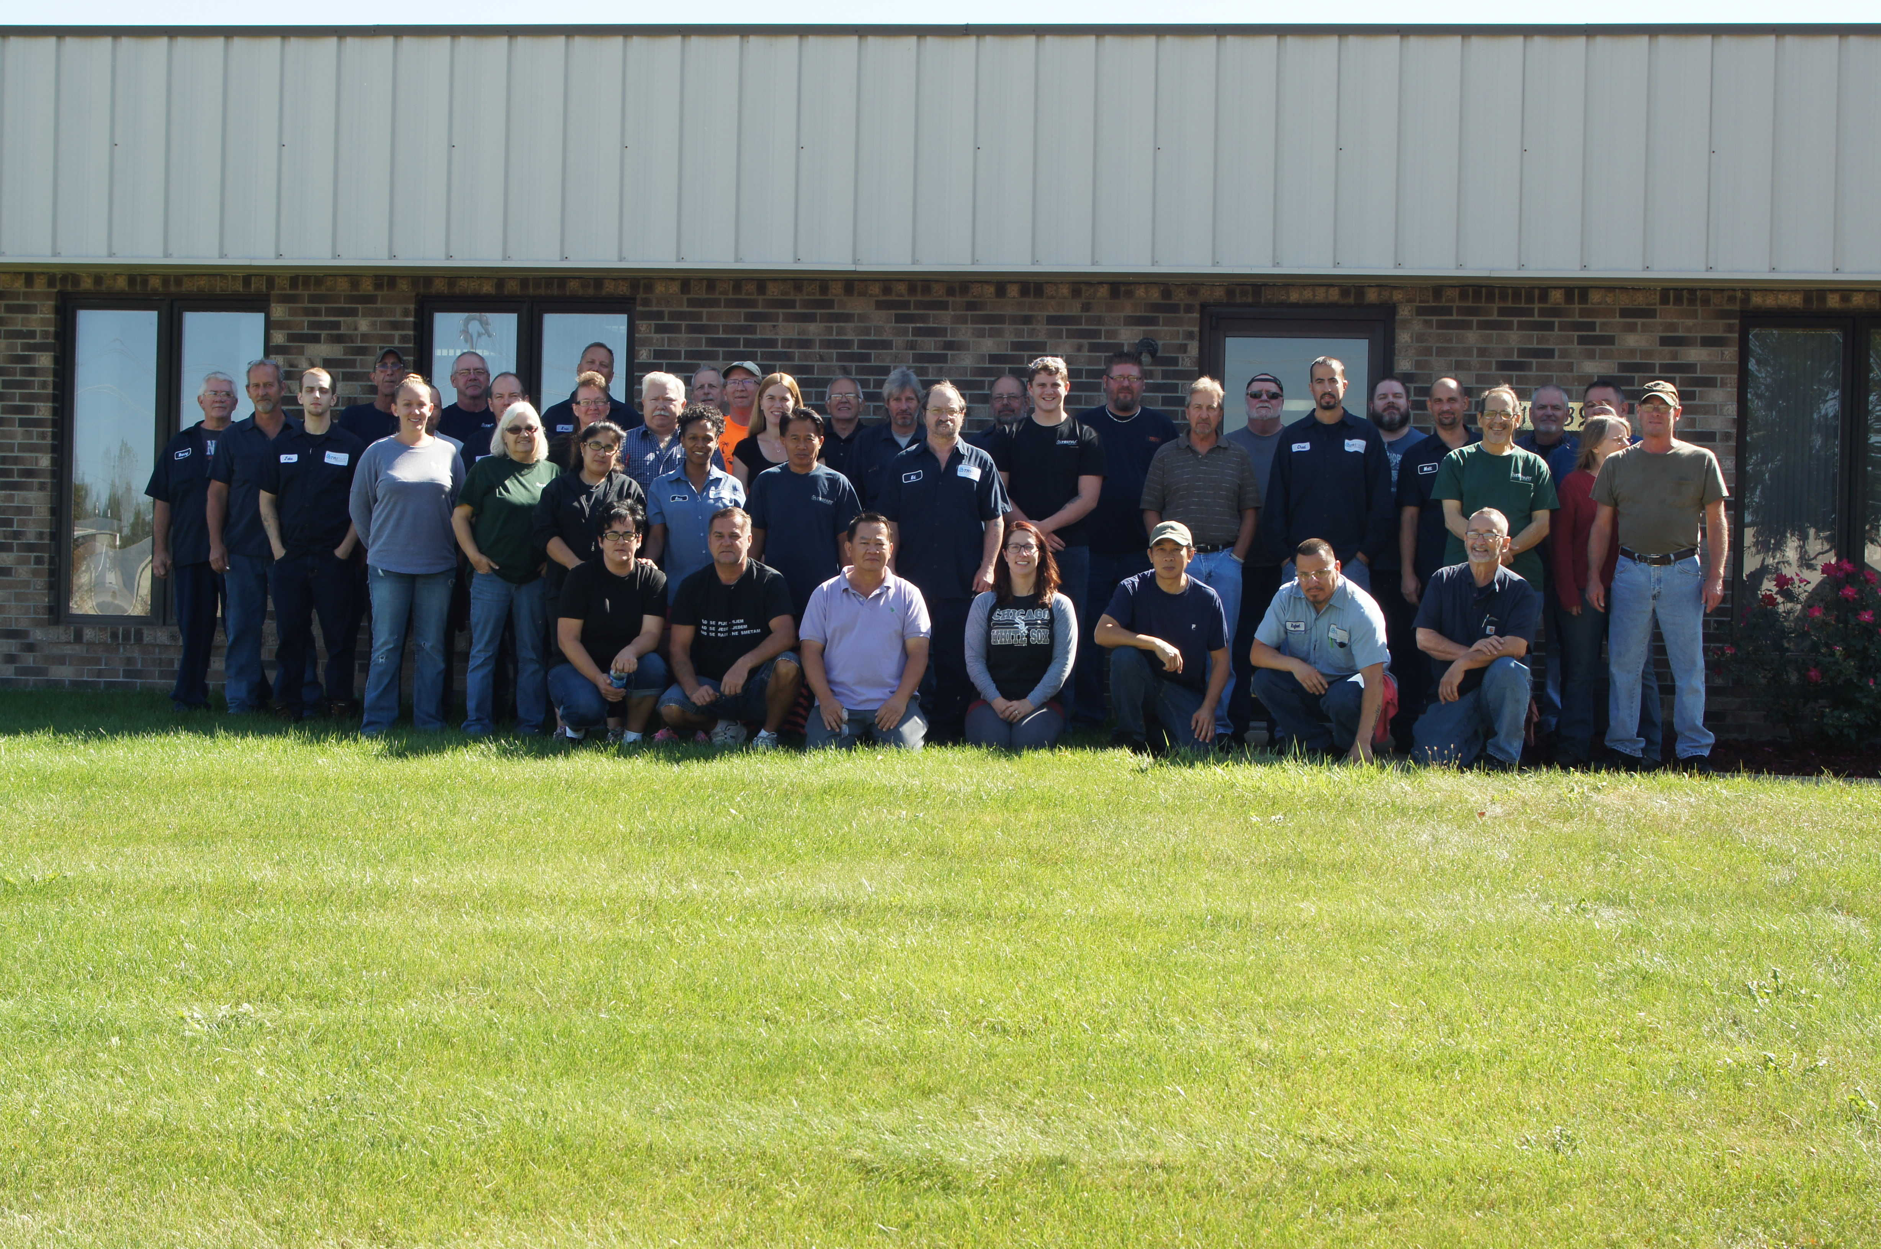
Thank You!
We look forward to working with you, and hope
to prove ourselves to be an excellent supplier
through our delivery, quality, service, and pricing.
Learn more at www.tri-part.com

